Slide 1

CHANNEL LOADING CALCULATOR
FOR
700 MHz Regional Planning Committee Guidance
By Joe Kuran
Wednesday March 9th 2016

Slide 3
This Channel Loading Calculator is designed for anybody interested in channel loading
Discover a fresh approach on how to determine the minimum number of channels needed.
With this calculator you will be able to preserve your valuable spectrum and still deliver optimal radio service.

Slide 4
The main subject at this time will be to focus on how to get valid data that goes into the calculator.
For existing system’s airtime is used.
That could be 1 radio talking 17 minutes.
or
17 radios each talking 1 minute

Slide 5
This empirical date is based on the C800/WCCCA Motorola 800MHz simulcast trunking system that covers Clackamas County and Washington Counties in Oregon.
GenWatch was used to extract the data from the Master Site for the year of 2013.

Slide 6
Based on the following statistics:
Agencies = 40
Talk groups = 75
Subscribers = 7500
Push-to-talks = 14 million
Airtime = 48 million seconds (1.5 years)
Repeater hang time = 200mSec
Erlang C default settings:
GoS (Grade of Service) = 1%
Busy Queue waiting time = 1 Second
Talk groups have the same priority 12.5KHz FDMA/2-Slot TDMA voice only
No Site restrictions
Data would be a separate element

Slide 7
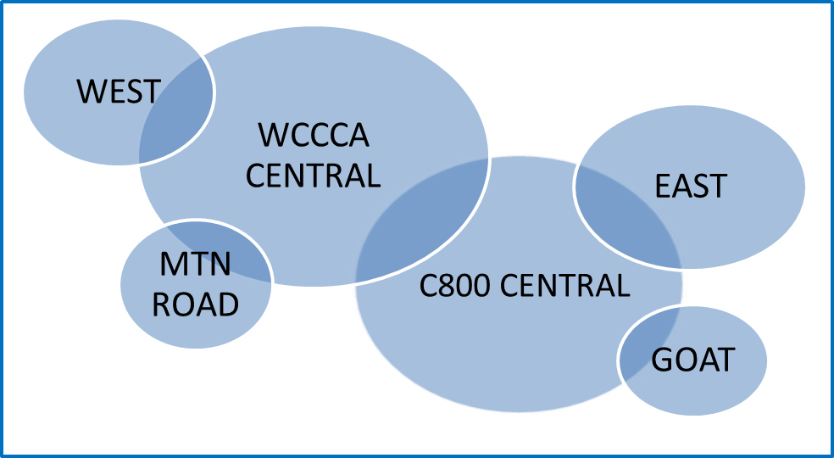
Site Originations vs: Site Involvement
Data is based on the sum of all PTT’s that originated from all cells

Slide 9
Radios in use per average peak hour per Talkgroup
WCSO1
40.98
269.7
6.59
The peak from each of the 365 days is than averaged

Slide 10
Radios Owned by Agency |  | 902 | WASHINGON COUNTY SHERIFF TALK GROUP BREAKDOWN for 2013
 |  | TOTAL | WCSO1 | WCSO2 | WCJAIL | WCSOTAC2 | WCSOTAC1 | CRTSEC | WCSODET | WCSO REC
1 | Daily (Avg Radios/Hour) averaged for the year | 61.16 | 23.24 | 11.61 | 20.40 | 1.58 | 1.33 | 2.59 | 0.33 | 0.08
2 | Daily (Peak Radios/Hour) averaged for 1 year | 121.36 | 40.98 | 23.04 | 31.86 | 6.98 | 6.18 | 8.72 | 2.48 | 1.13
3 | Daily (Ave PTT/Hour) averaged for the year | 339.36 | 134.62 | 101.48 | 75.01 | 7.48 | 6.37 | 10.94 | 3.33 | 0.15
4 | Daily (Peak PTT/Hour) averaged for 1 year | 818.15 | 269.65 | 226.95 | 148.12 | 44.58 | 41.46 | 54.36 | 30.38 | 2.65
5 | Total Airtime for the year secs | 11,342,881 | 4,507,236 | 3,398,815 | 2,359,831 | 407,835 | 351,051 | 254,999 | 60,472 | 2,643
6 | Total PTT for the year | 2,928,434 | 1,179,230 | 888,985 | 657,050 | 65,327 | 55,626 | 70,861 | 10,712 | 643
7 | Ave PTT per radio per hour(in 1 year period) | 4.71 | 5.77 | 8.71 | 3.66 | 4.66 | 4.68 | 3.97 | 4.39 | 1.82
8 | Peak PTT/radio/hour(in 1 year period) | 6.23 | 6.59 | 9.97 | 4.67 | 6.49 | 6.64 | 5.93 | 7.47 | 2.09
9 | Ave PTT duration(in 1 year period) secs | 4.41 | 3.82 | 3.83 | 3.59 | 6.40 | 6.35 | 3.60 | 3.90 | 3.83
10 | Peak PTT duration(in 1 year period) secs | 23.34 | 32.98 | 34.57 | 17.20 | 36.43 | 34.19 | 17.25 | 8.95 | 5.18
11 | Airtime minutes per hour |  | 17.18 | 14.47 | 8.86 | 4.75 | 4.39 | 3.26 | 1.98 | 0.17
Than the total for each Talkgroup from each agency is either summed or averaged
Standard Deviation for WCSO1 Peak Radios/Hour = 5.3
Standard Deviation for WCSO1 Peak PTT/radio = 0.9

Slide 11
Than the channel loading from each Talkgroup was calculated.
TRUNKING SYSTEM CHANNEL LOADING CALCULATOR Based on Erlang C due to queue
Trunking System, Erlang C due to queue | 1 | 2 | 3 | 4 | 5 | 6 | 7 | 8
AGENCY TALKGROUPS | WCSO1 | WCSO2 | JAIL | TAC2 | TAC1 | CRTSEC | DET | REC | TOTAL | AVE
Total Radios owned by Agency | 902 | 902 | 902 | 902 | 902 | 902 | 902 | 902 | 902
Ratio of Active Radios to Radio Owned | 4.54% | 2.55% | 3.53% | 0.77% | 0.69% | 0.97% | 0.27% | 0.12% | 13%
Actual Radios in use per Hour | 41.0 | 23.0 | 31.9 | 7.0 | 6.2 | 8.7 | 2.5 | 1.1 | 121
PTT's per radio | 6.6 | 10 | 4.7 | 6.5 | 6.6 | 5.9 | 7.4 | 2.0 |  | 6.2
Total Number of PTT per hour | 269.6 | 226.9 | 148.1 | 44.6 | 41.5 | 54.4 | 30.4 | 2.6 | 818
PTT Duration in Seconds | 3.8 | 3.8 | 3.6 | 6.4 | 6.3 | 3.6 | 3.9 | 3.8 |  | 4.4
Erlangs | 0.2863 | 0.2412 | 0.1476 | 0.0792 | 0.0731 | 0.0544 | 0.0329 | 0.0028 | 0.9175
Performance Objectives
reference waiting time queue in sec (W0) | 1 | second(s) | Busies of 1 second or less are considered acceptable. This time is user determined
GoS P(W>W0) | 1% |  | 1 busy over 1 second per 100 PTT's is considered acceptable. Grade of Service is user determined
Offered Traffic Characteristics
Call traffic (Erlangs) | 0.92
Average Holding Time | 4.41 | second(s)
System Type | FDMA | TDMA | Assuming 12KHz channel bandwidth and 2-Slot TDMA in 12.5 KHz channel
Frequencies Needed | 4 | 3 | Frequencies include FDMA control channel
Probability that a call has to wait | 1.53% |  | Probability that call will not be handled immediately
Probability that a call has to wait more than W0 | 0.76% |  | If the GoS of 1% is entered in line 15, than any thing 1 second or under is considered acceptable.

Slide 12
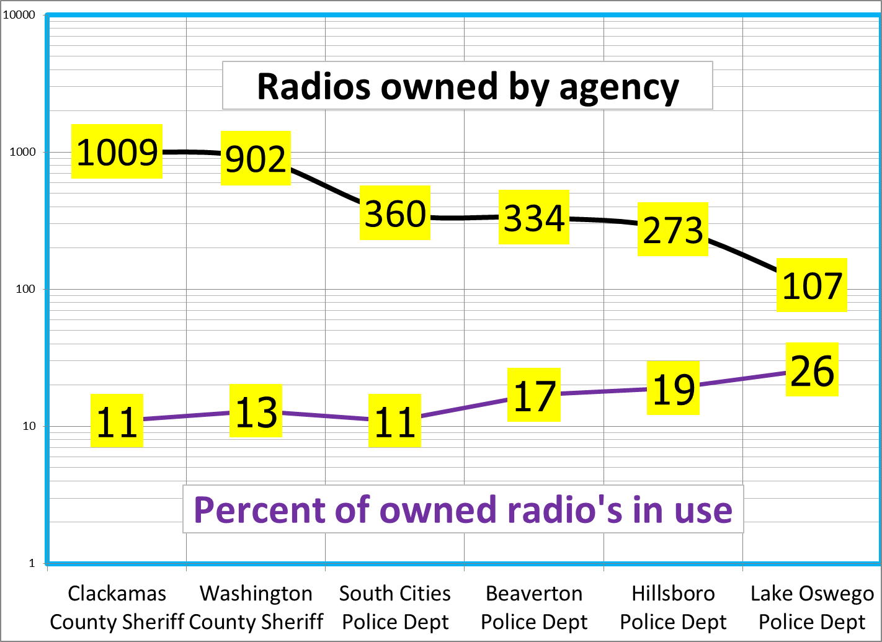
Note: CCSO includes Sheriff radios plus all local police in Clackamas County

Slide 13
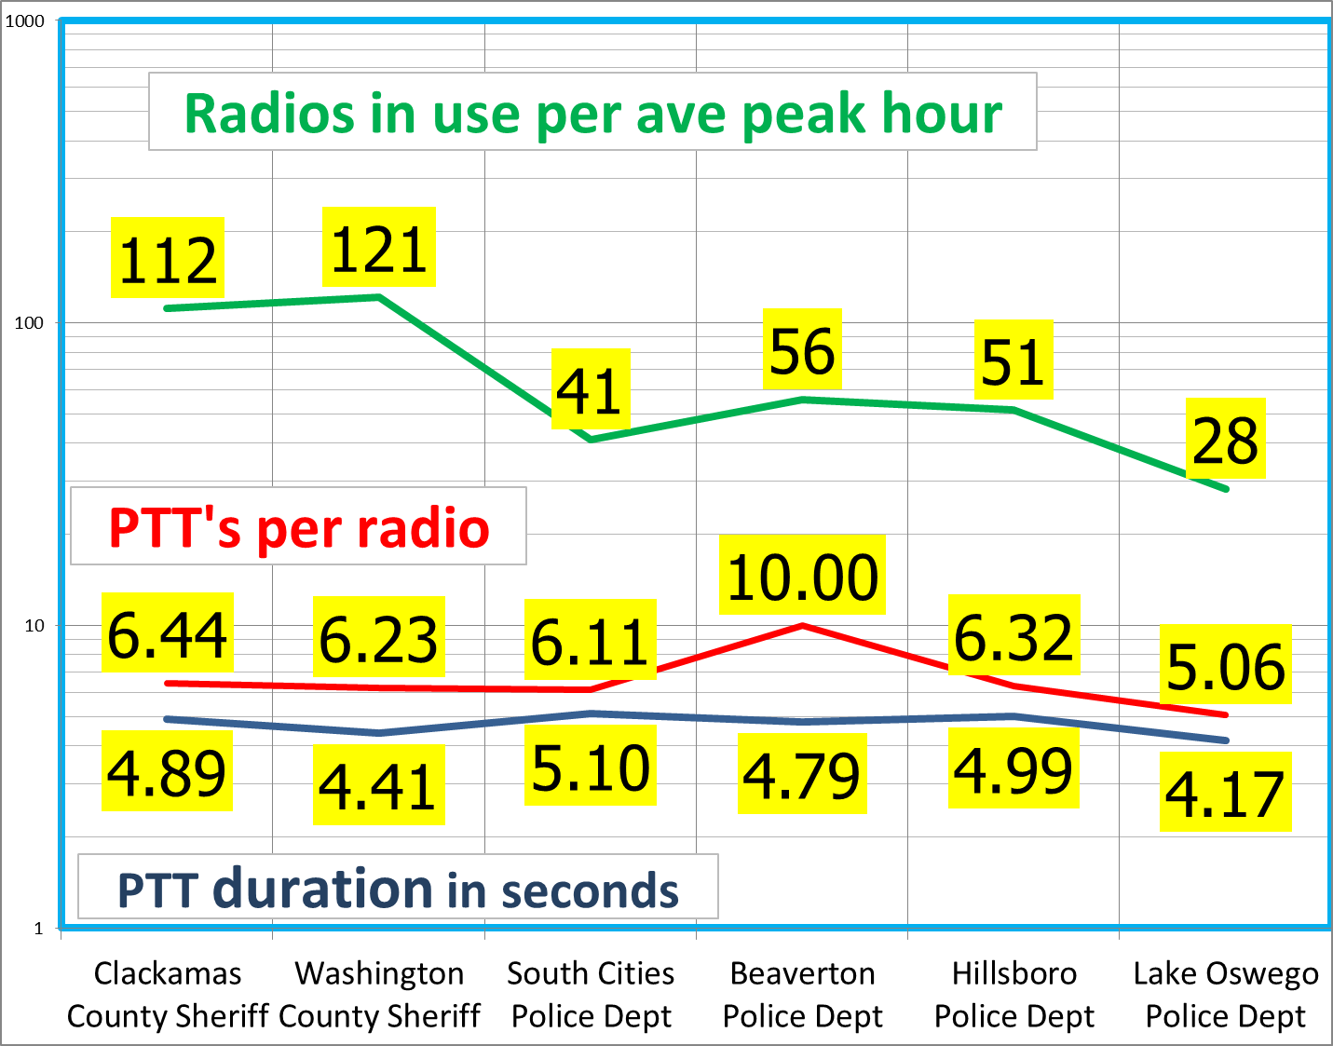

Slide 14
Reference based on Empirical data from multiple agencies
Key #:6 PTT’s/radio at 5 sec duration from 600 radios/hour
TRUNKING SYSTEM CHANNEL LOADING CALCULATOR REFERENCE SHEET
Column1 | WCFire | CCSO | WCSO | SCPD | BPD | HPD | PW | NBFD | LOPD | H-Sec | Bus | TOTAL | AVE
Talk Groups | 9 | 10 | 8 | 7 | 7 | 6 | 2 | 3 | 4 | 2 | 2 | 60
Owned radio | 1112 | 1009 | 902 | 360 | 334 | 273 | 188 | 148 | 107 | 55 | 41 | 4529
Percent 20 | 8% | 12% | 13% | 12% | 17% | 19% | 8% | 20% | 26% | 43% | 38%
Actualradio | 92 | 125 | 121 | 42 | 56 | 51 | 14 | 30 | 28 | 24 | 15 | 600 | 13%
PTT's/radio | 4 | 6 | 6 | 6 | 10 | 6 | 4 | 4 | 5 | 7 | 7 |  | 6
Total PTTs | 398 | 805 | 818 | 257 | 559 | 325 | 55 | 120 | 143 | 178 | 101 | 3775
Seconds/ptt | 7 | 5 | 4 | 5 | 5 | 5 | 4 | 6 | 4 | 4 | 4 |  | 5
Erlangs | 0.7 | 1.1 | 1.0 | 0.4 | 0.7 | 0.5 | 0.1 | 0.2 | 0.2 | 0.2 | 0.1 | 5.2
Queue | 1 | Busies of 1 second or less acceptable.
GoS | 1% | 1 busy over 1 sec per 100 PTT's
Erlangs | 5.2 | All talkgroups are at the same priority level
PTT sec | 5
Type | FDMA | TDMA | 12KHz B/W and 2-Slot TDMA in 12.5 KHz ch
Freq's | 12 | 7 | Frequencies include FDMA control channel
Wait>1 | 1.6% |  | Probability
Wait<1 | 0.5% |  | Probability

Slide 16
67radios in use per hr/talk path. 67 x 6 PTT x 5 sec = 33.5 minutes of airtime per talk path per hour. About 50% max loading per talk path.
FDMA
1950
radios
16 freq needed
1750
radios
TDMA
9 freq needed
When GoS exceeds 1% channel is added
1000/15 talk paths = 67 radios/talk path

Slide 17
This example assumes 25% of 4000 radios are active

Slide 18
The WCCCA Central simulcast provides the majority of the coverage for the WCSO (Washington County Sherriff’s Office) subscribers and home of the WCCCA dispatch center. The C800 Central simulcast provides the majority of the coverage for the CCSO (Clackamas County Sherriff’s Office) subscribers and home of C800 dispatch center.
The ATIA data discovered that about 95% of the WCSO radios originated their calls on the WCCCA Central simulcast system and that about 97% of the CCSO radios originate their calls on the C800 Central Simulcast system. This data is what was used to provide PTT count for this study.
Now the ATIA data revealed that about 81% of the 95% WCSO calls were involved on the C800 system and that about 95% of the 97% CCSO calls were in involved on the WCCCA system.
Since the C800/WCCCA system has no site restrictions, it allows all units/talkgroups to access all sites. Digging deeper into the data reveals that there is the small amount of involvement on all the calls for a majority of originated calls.

Slide 19
Dispatcher Radio Involvement time
WCSO1 Dispatch
41 Radios Per Hour
7 PTT’s per radio per hour
4 seconds duration per PTT
41 times 7 = 287 PTT’s per hour
287 times 4 seconds = 1,148 seconds = 19 minutes of airtime per hour
Assume 3 PTT’s per conversation = 287/3 = 96 conversations per hour
Each conversation = 4 seconds times 3 PTT’s = 12 seconds airtime per conversation Add 1 seconds per PTT to pick up mic,etc = 12 + 3 = 15 seconds per conversation.
Add 10 sec for dispatcher to update CAD entries. 15 + 10 = 25 sec per conversation Dispatcher involvement = 96 conversations x 25sec = 40 minutes per hour

Slide 20
References
This basic layout would not have been possible without all the help from Guy Jouannelle at Televate LLC.
Final report of the PSWAC (Public Safety Wireless Advisory Committee) 1996
Page 702 has some calculations that predicted future busy hour airtime.
It states that each officer would generate 3.7 minutes of airtime per hour.
In contrast, my data for WCSO1 shows 41 officers(radios) each generating 7 PTT’s per hour at 3.8 seconds each. That results in each officer generating 27 seconds per hour.
And that one message is comprised of (3) three (5) five second transmissions.
Interesting that the data in this document refers to the book by Garry G. Hess.
Land-Mobile Radio System Engineering by Garry G. Hess 1993
Chapter 13 in this book addresses engineering aspects of a radio system’s capacity to carry messages, or radio traffic.
The message times per call were based on early 90’s data. This was before the wide spread use mobile data and cell phones and telephone interconnect on the trunking system. The author believes that today’s call lengths are much shorter and therefore more users per channel is possible.
Many thanks to EF Johnson. http://go.efjohnson.com/systemdesign

